Slide 1
“DIXON GROWN” RECAP & REVISIONS TO CEQA NOTICE OF PREPARATION (NOP) MAP
Agenda
“Dixon Grown” Outreach update
2. Revisions to CEQA Notice of Preparation (NOP) Map

Slide 2


Community Outreach Update

Slide 3

Summary
To support the launch of the Dixon Grown initiative and its workshop series in March 2026, the City of Dixon implemented a public outreach campaign designed to maximize awareness, participation and transparency around city development efforts. Outreach efforts combined digital, print and in-person engagement strategies.

Slide 4
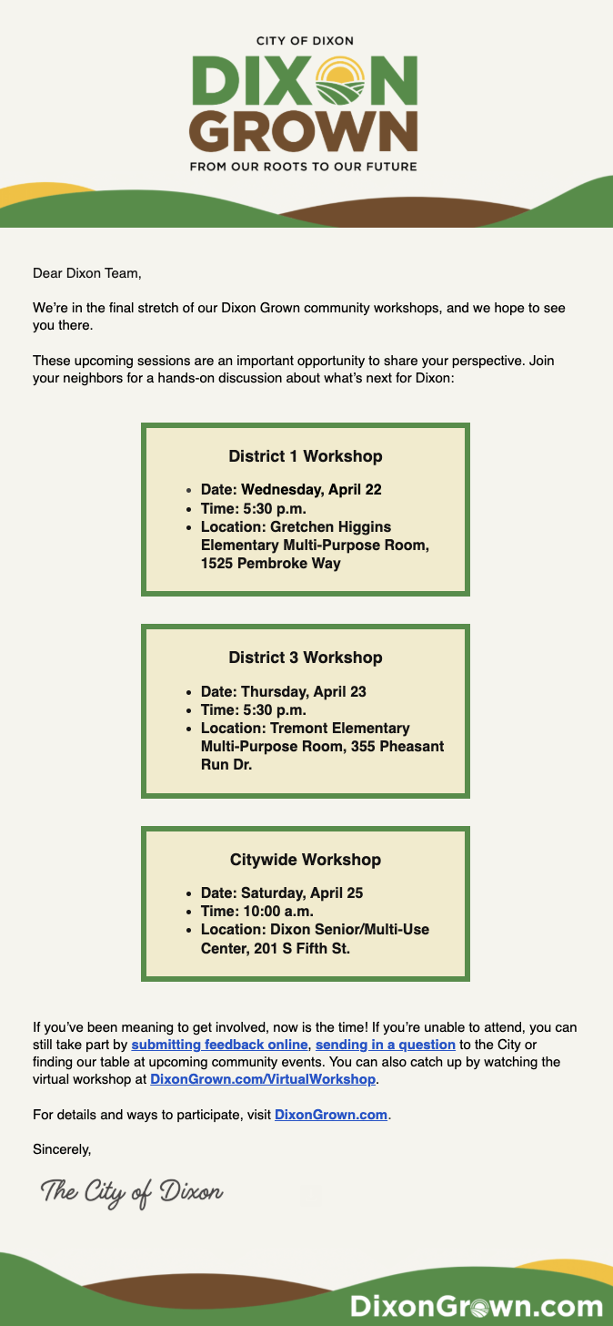
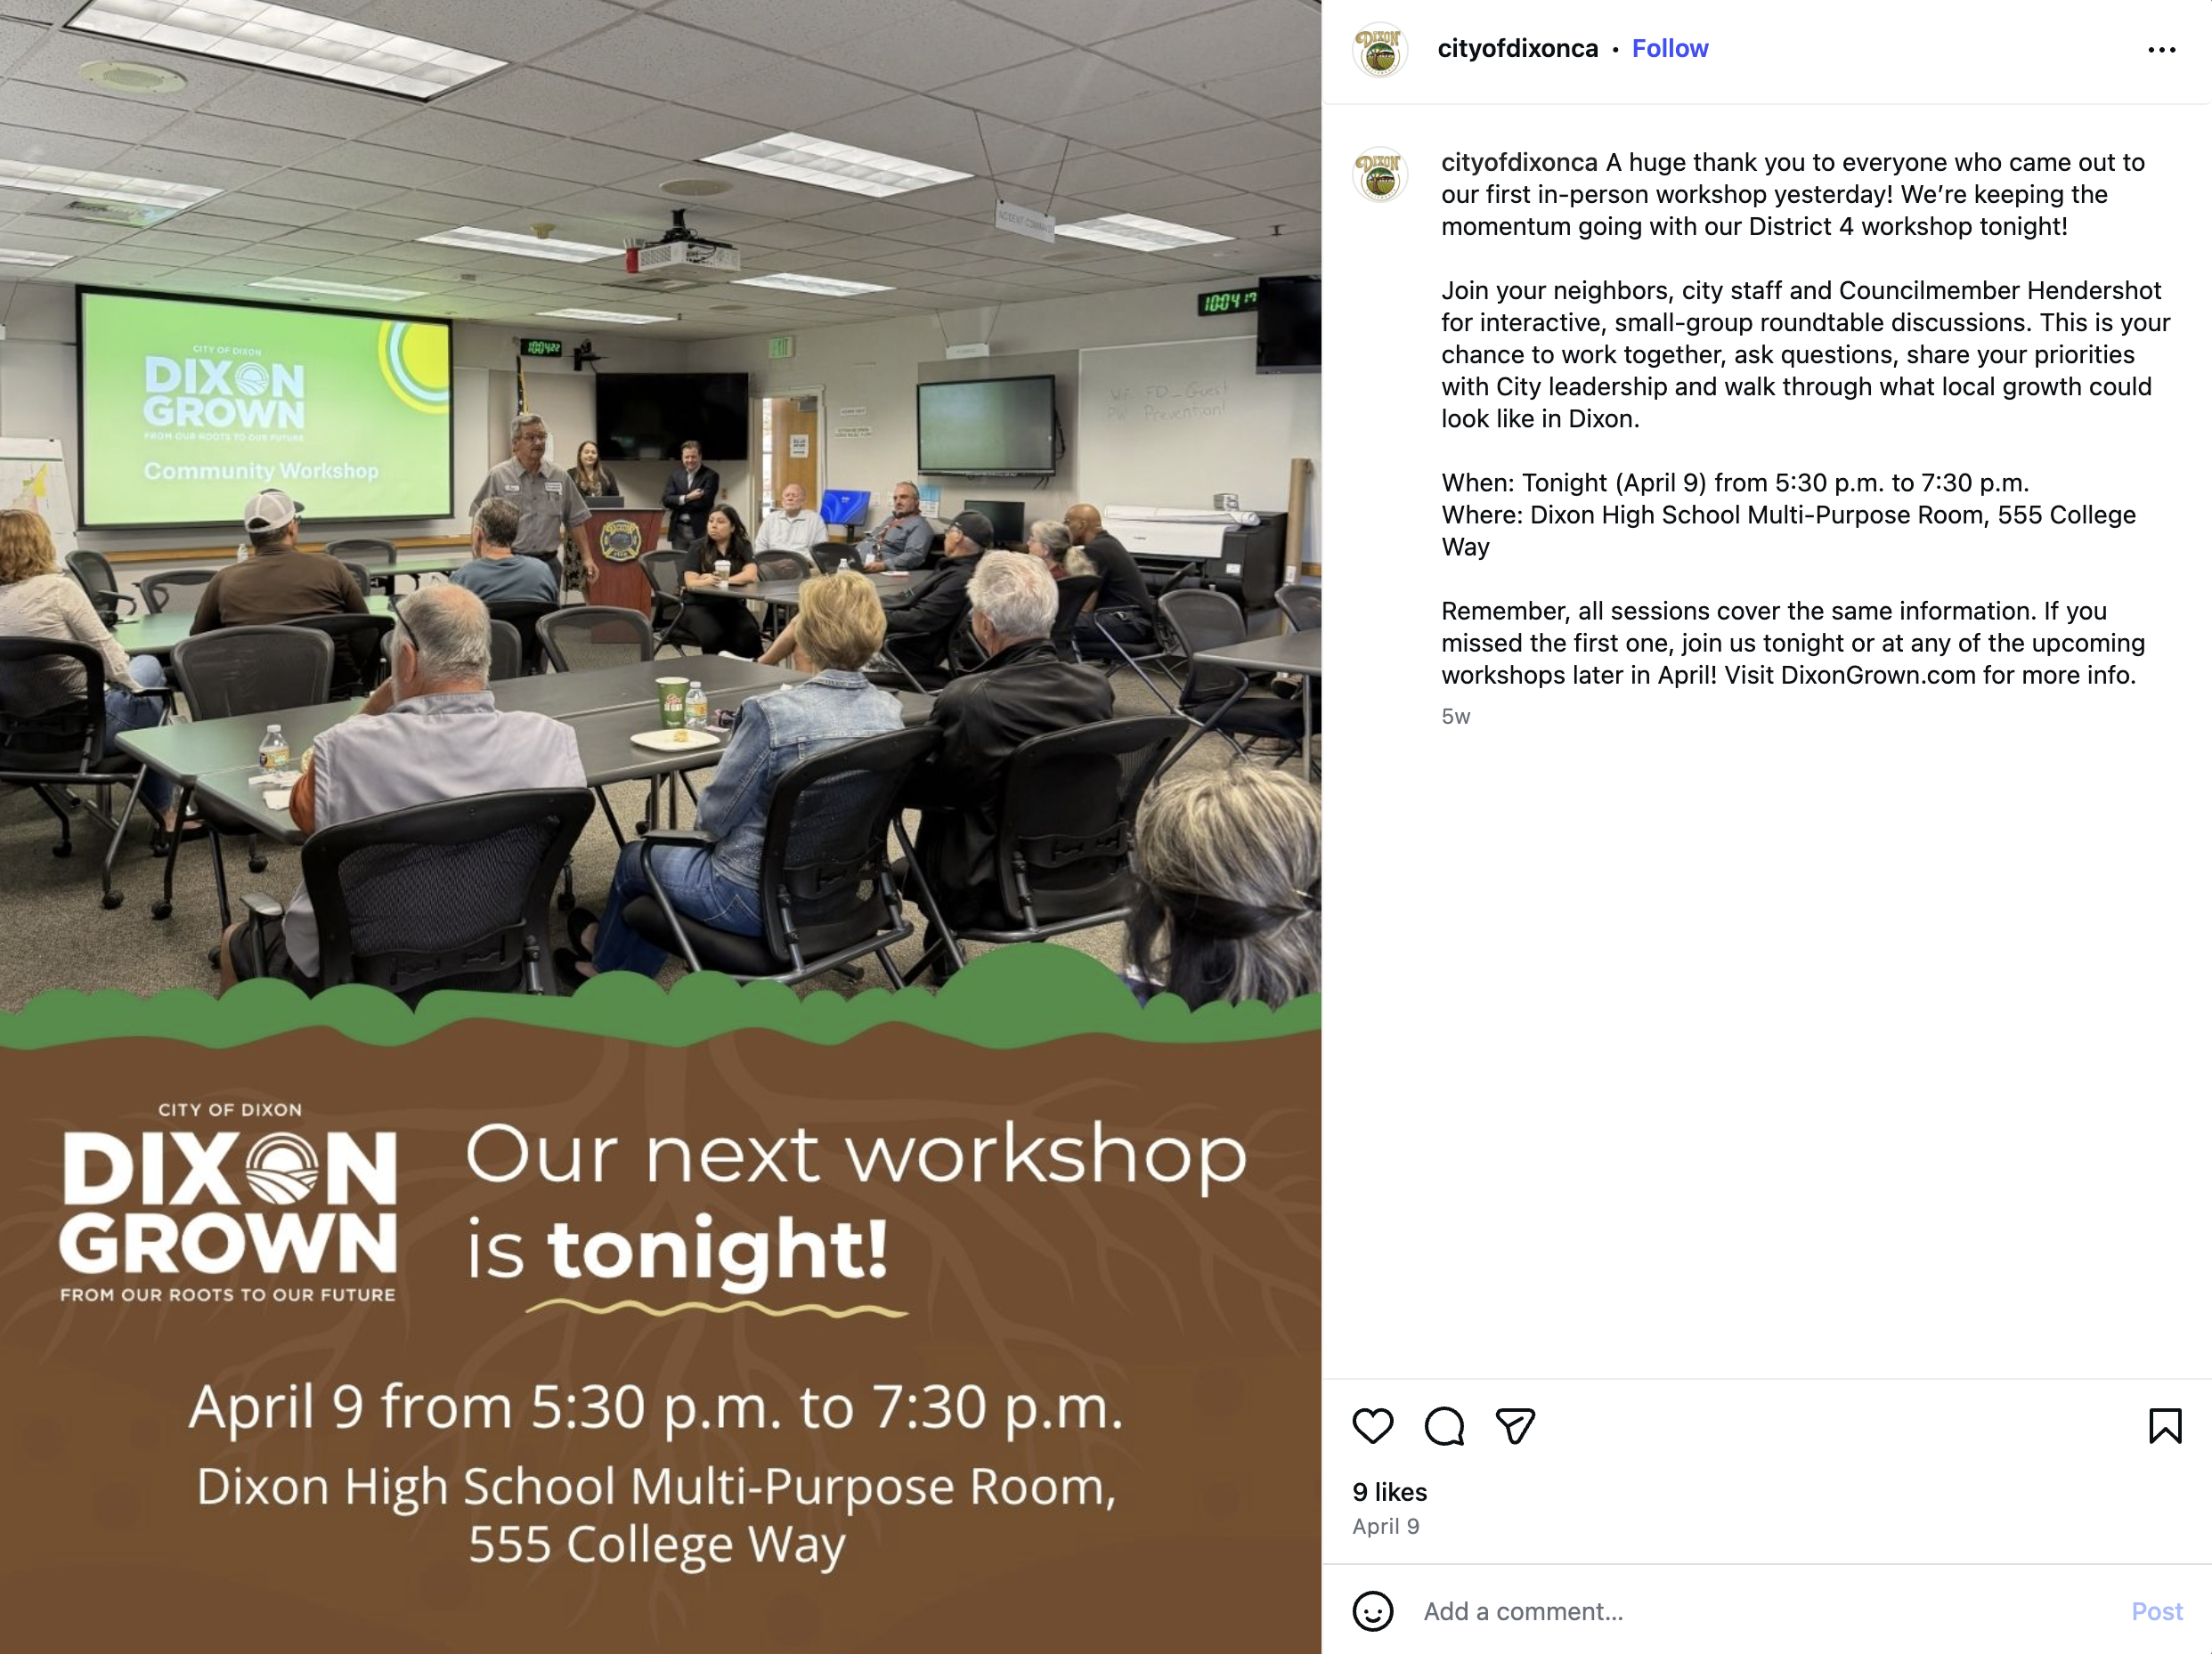
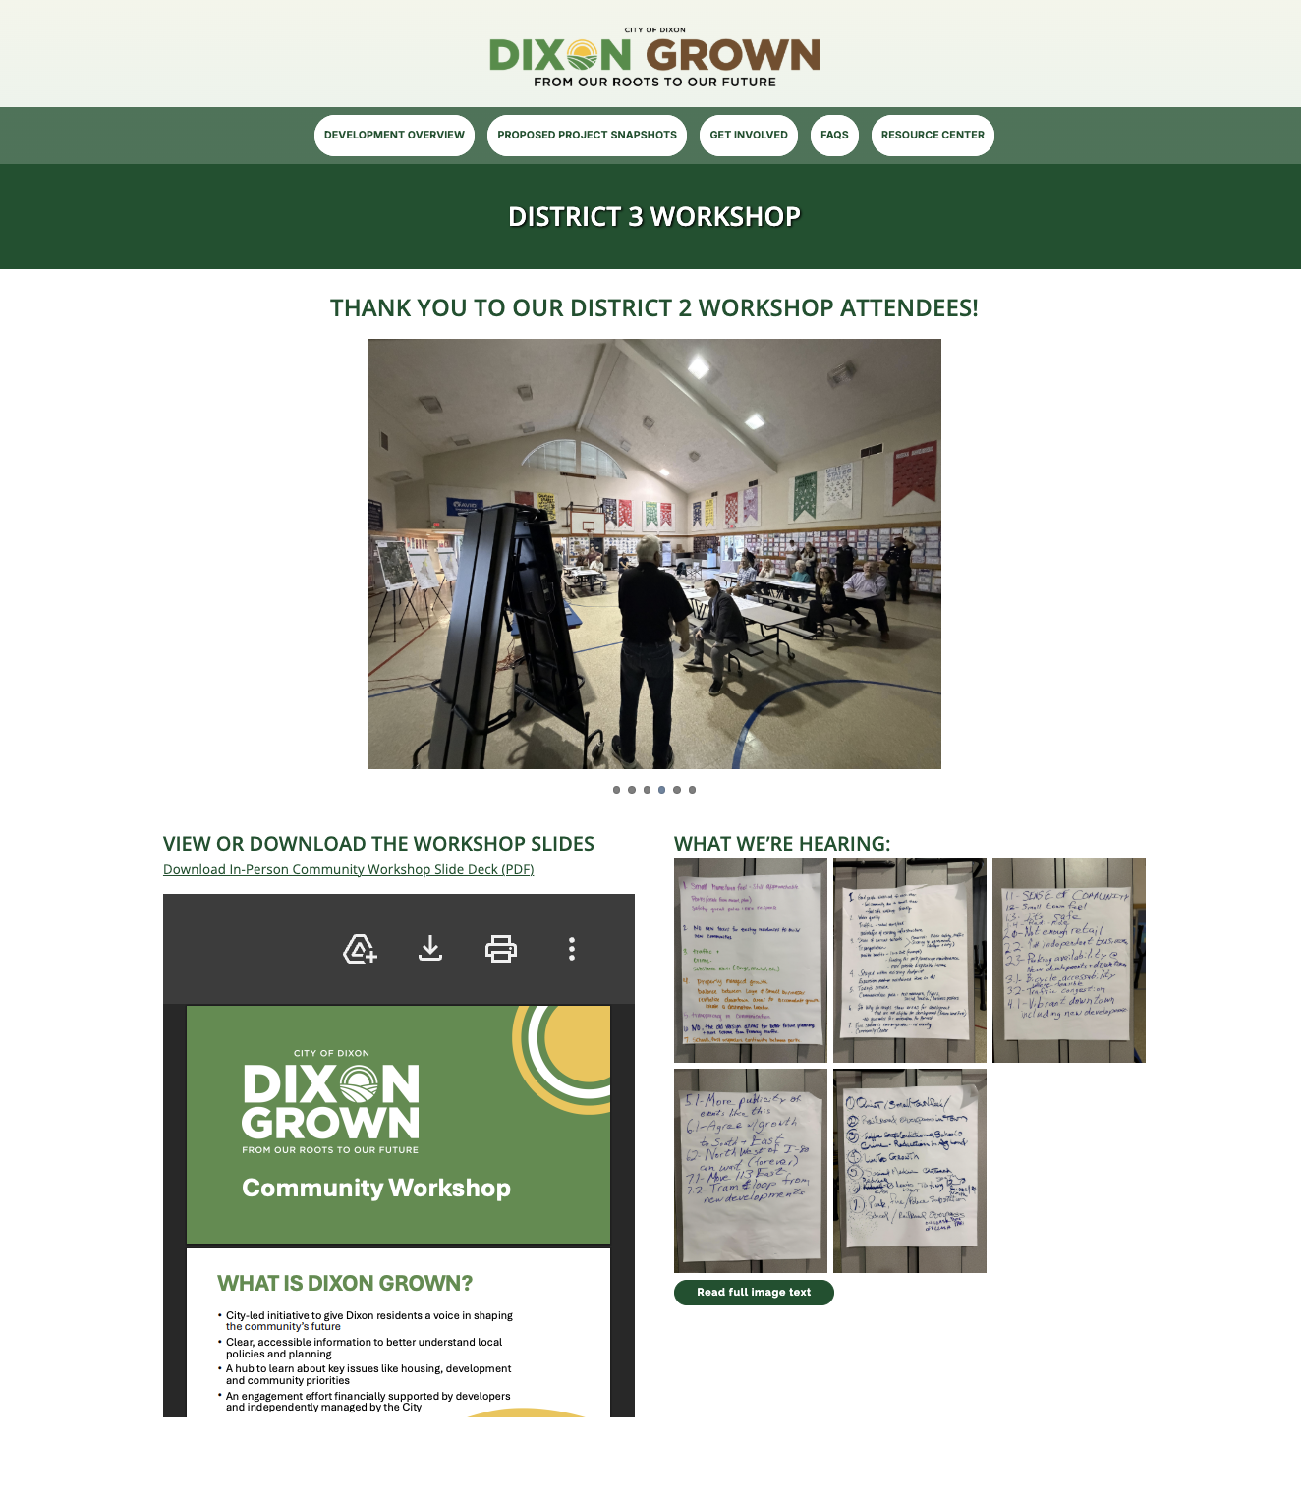

Digital Outreach
Email Campaign
DixonGrown.com Landing Pages
Social Media
Dedicated workshop landing pages featuring:
Workshop schedules and updates
Meeting materials and presentations
Community survey and feedback opportunities
Recorded virtual workshop access
5 targeted emails distributed to a subscriber list of more than 1,300 residents with an average open rate of 59.6%
# of interactions:
1,075
Campaign performance totals:
16 posts
26,800+ total social media impressions/reach
140+ engagements
63 comments
9 shares
# of views:
350

Slide 5
Print and Community Outreach
Every Door Direct Mail (EDDM) campaign reaching 9,145 households and businesses
Utility bill inserts in 6,840 paper bills
and 429 e-bills
Lawn signs
Pardi Plaza banner installation
Digital billboard display
Flyers
Business cards
Press releases (picked up by the Daily Republic)

Slide 6
Feedback Context (Form + Workshops)
The input collected through the Dixon Grown workshops and feedback form reflects qualitative feedback from self-selected participants.
These engagement activities were designed to foster community dialogue, surface local priorities and gather a range of perspectives, rather than to produce statistically representative survey results.
The findings highlight common themes and ideas voiced by participants and should be understood as illustrative of community input, not a comprehensive or statistically precise measure of opinion across the Dixon community.

Slide 7
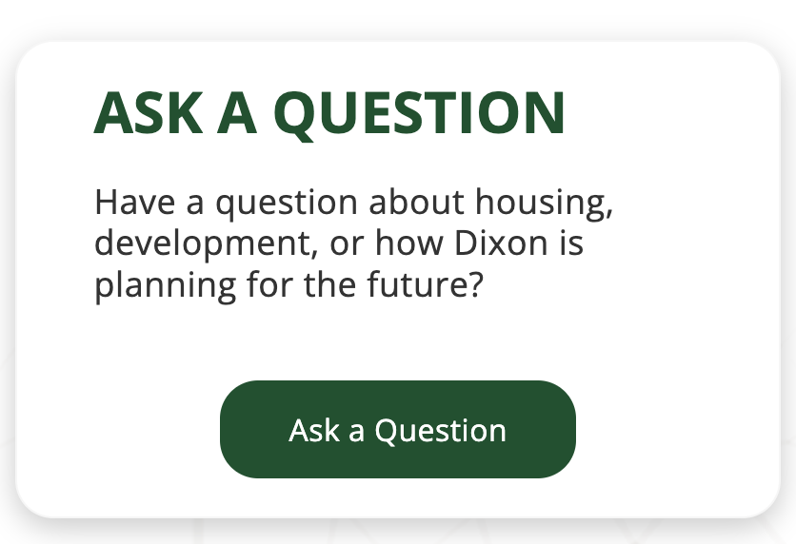
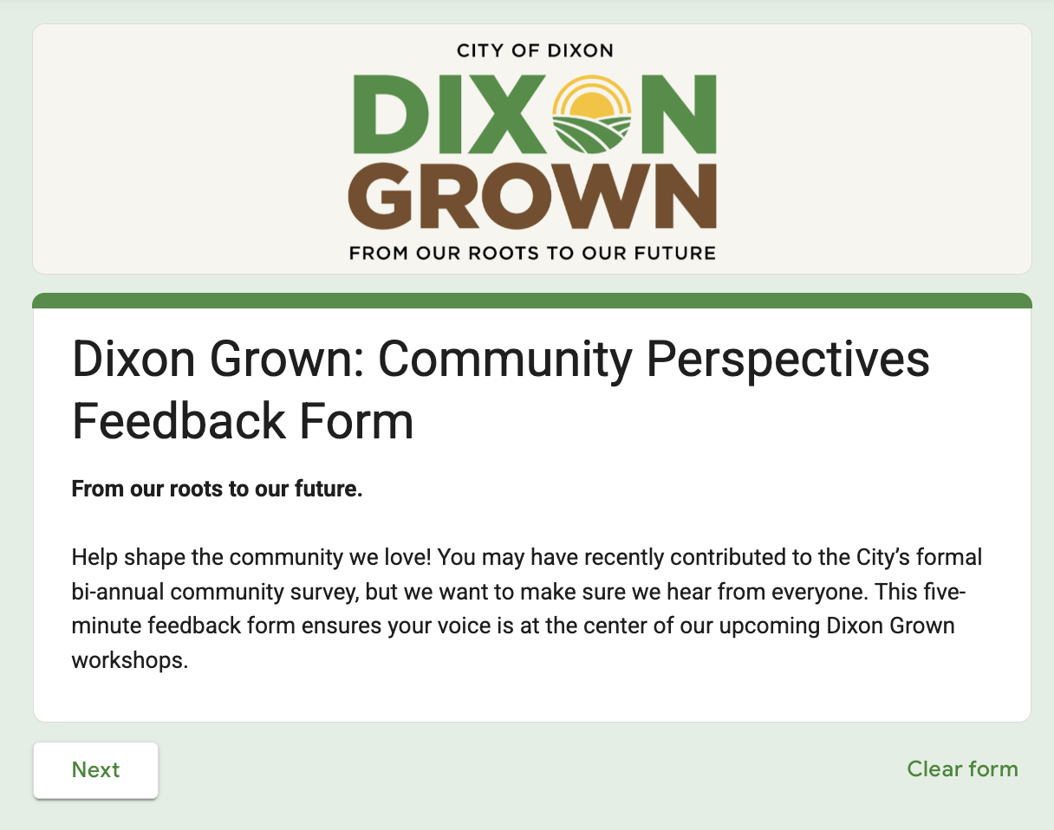
Community Feedback
Participation
Community feedback form generated 53 resident responses as of 5/19/2026
Residents also submitted questions directly through DixonGrown.com, creating an ongoing channel for public input and dialogue with the City
  Seven submissions have been received as of 5/19/2026

Slide 8
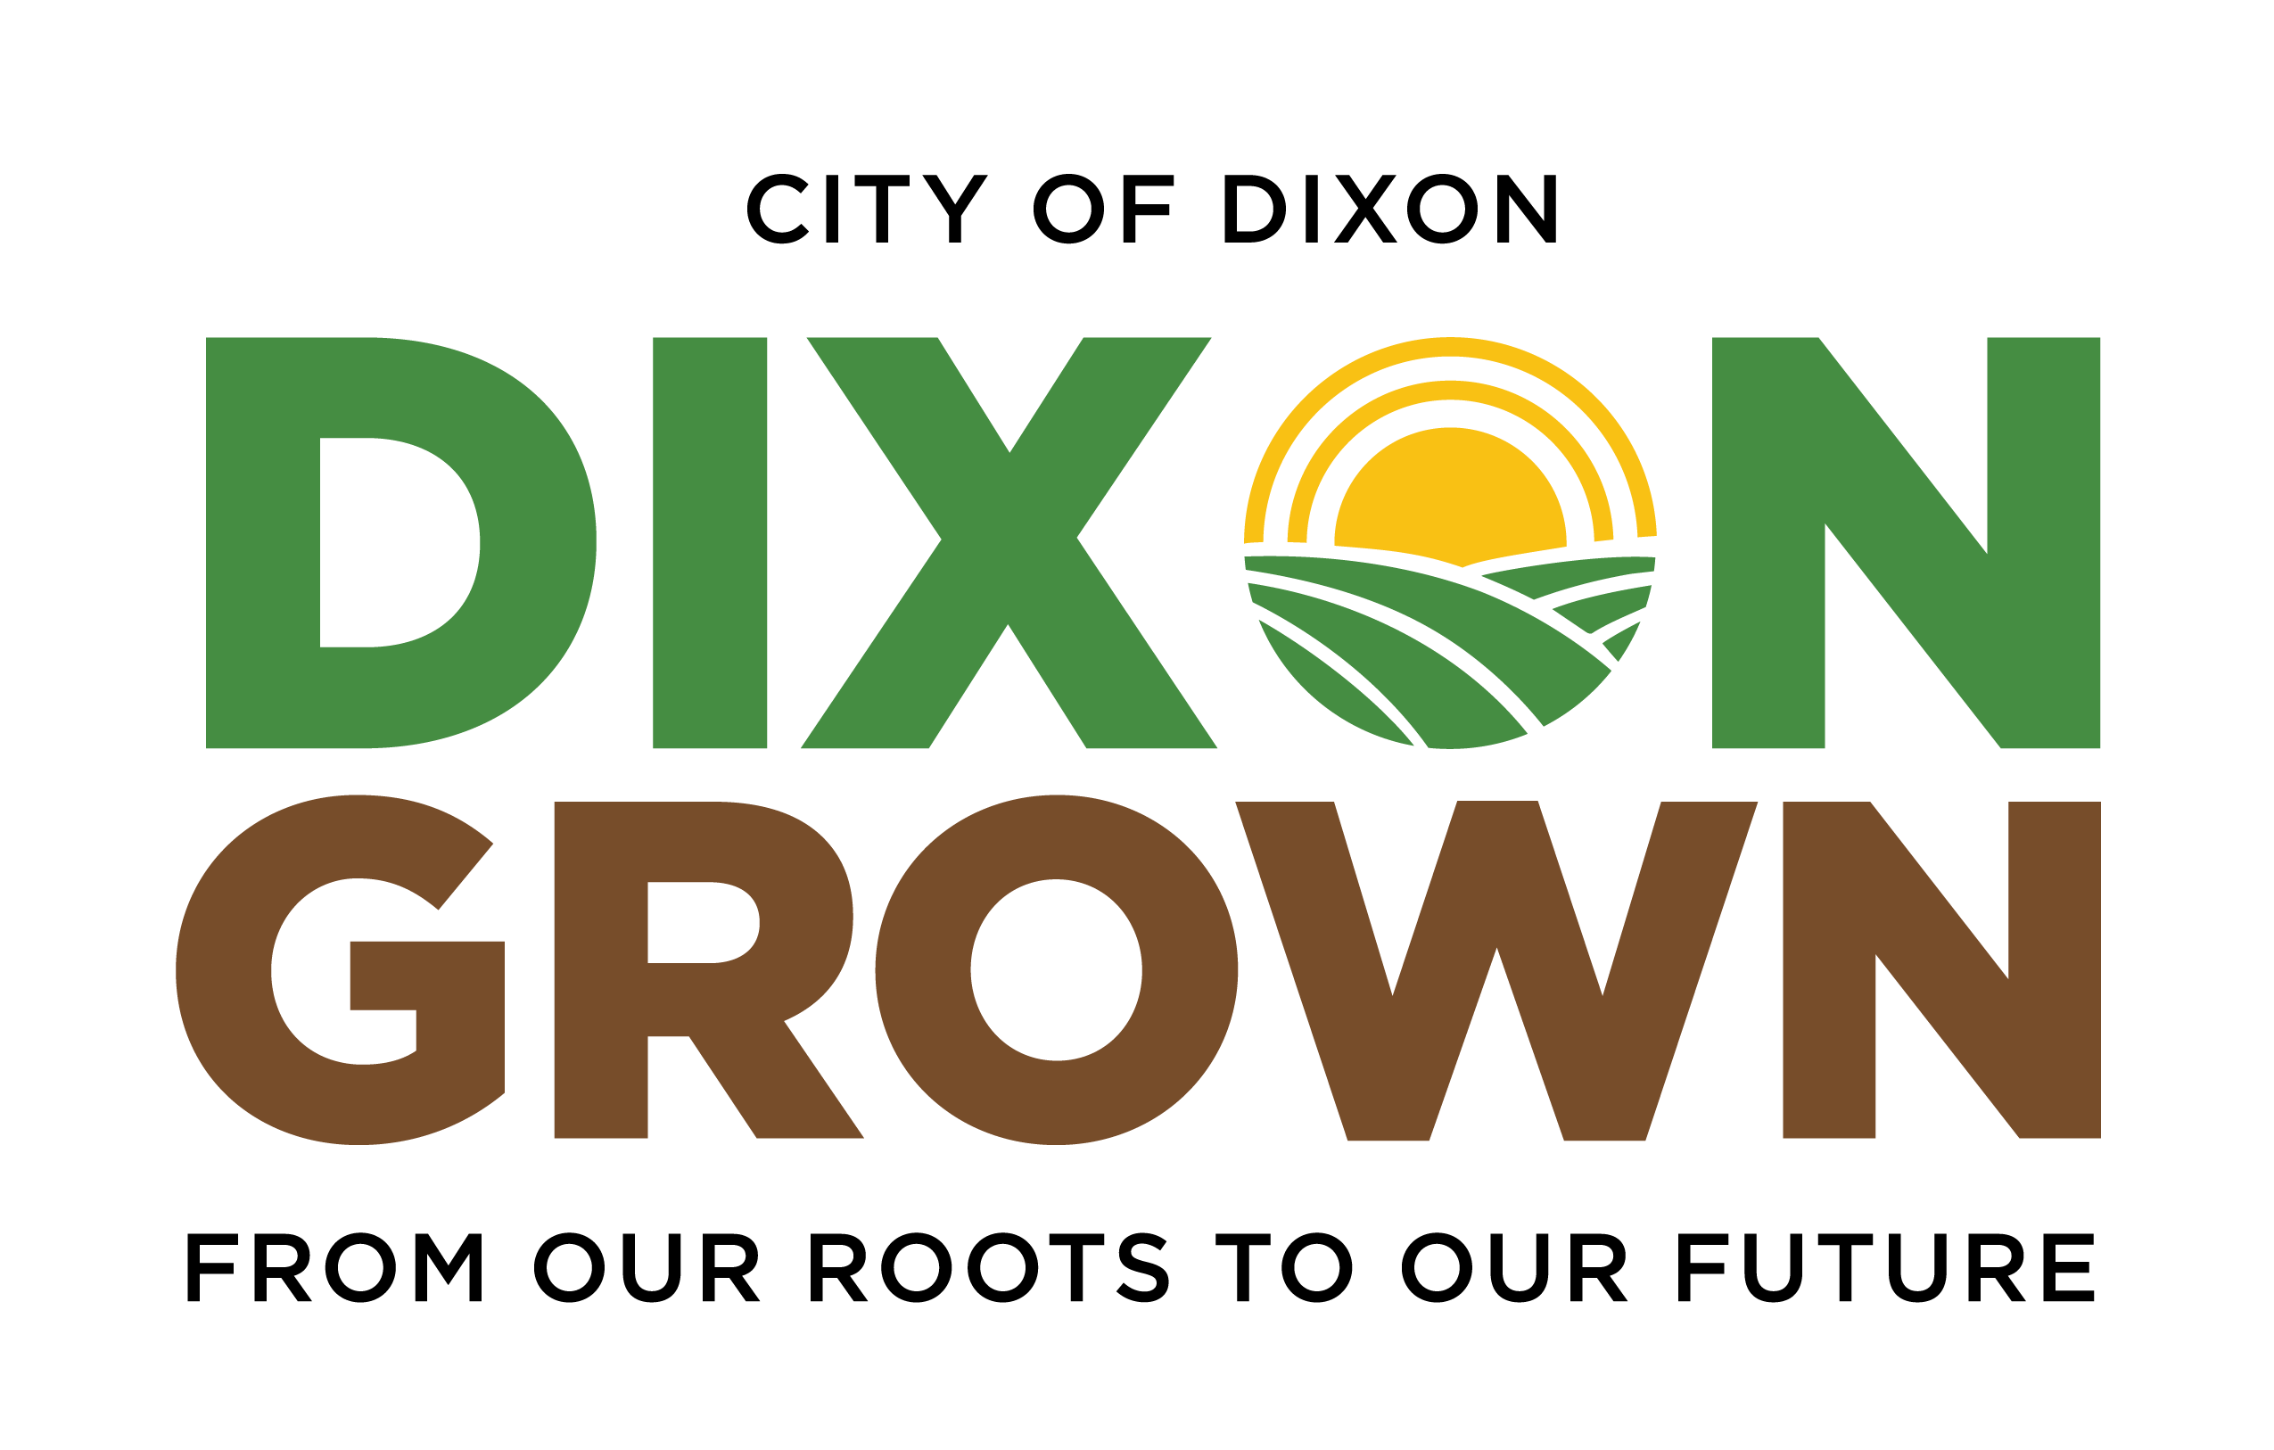
Community Feedback Form Themes
Protect Dixon’s Identity
  Desire to maintain friendly neighborhoods, historic downtown, agriculture and walkability that give Dixon its small-town character.
Downtown Revitalization
  Support for a vibrant, walkable downtown and neighborhood connectivity
Infrastructure Before Growth
  Don’t sacrifice roads, utilities, public safety, traffic and water systems before new development.
Interest in Developer-Funded Infrastructure
  Preference for developer-funded infrastructure over new taxes on existing residents.
Invest in Parks and Community Spaces
  Interested in parks, trails, playgrounds and public gathering spaces.
Concerns with Rapid Growth
  Frustration over residential growth potentially outpacing infrastructure, traffic solutions and retail/services.
Transparency and Local Control
  Participants want clearer communication on growth limits, state mandates, infrastructure timelines
  and future development plans.

Slide 9
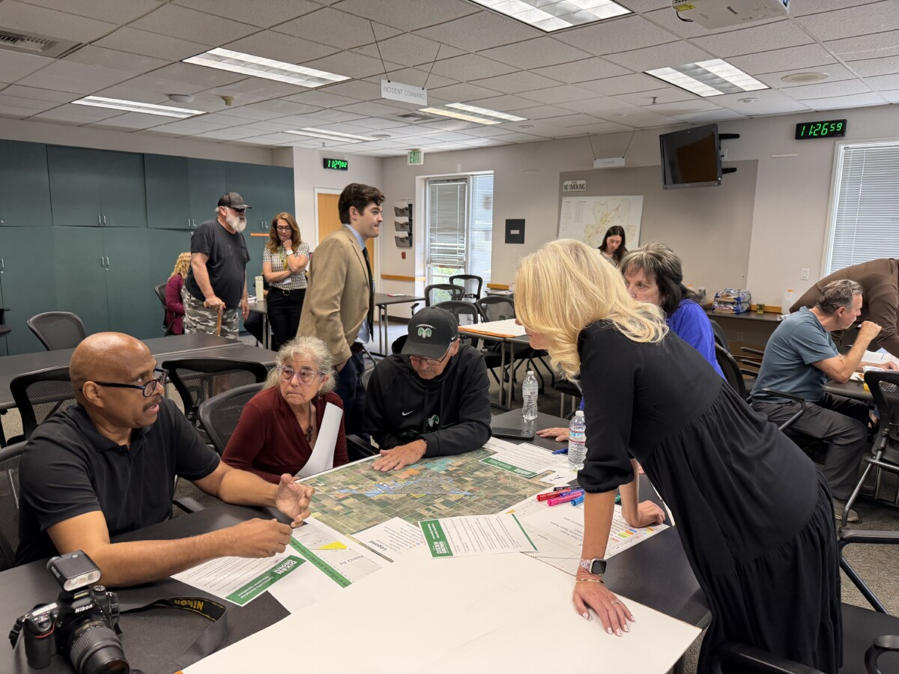
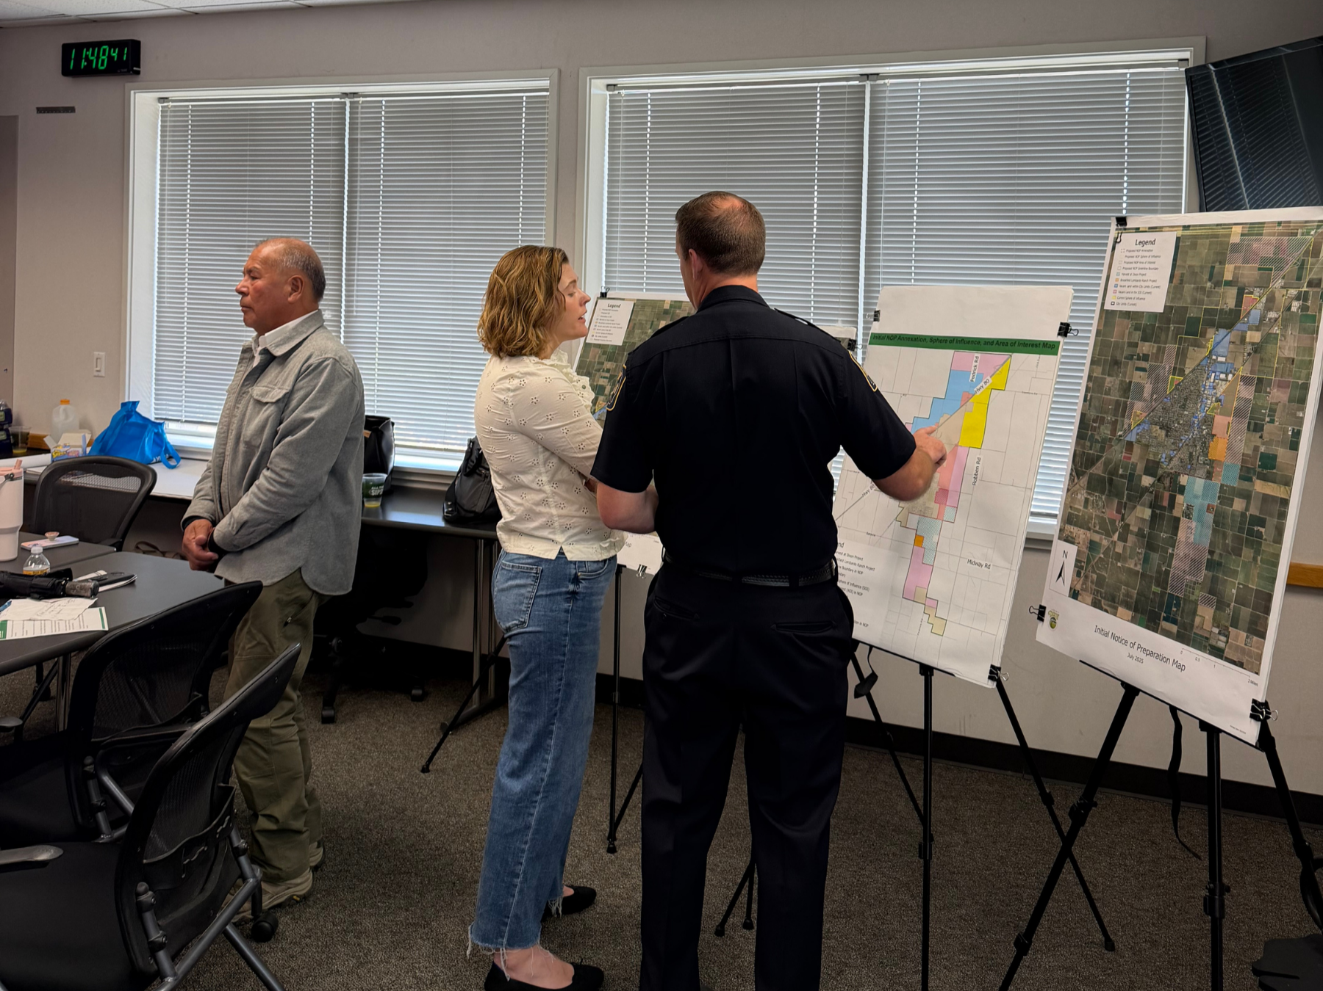
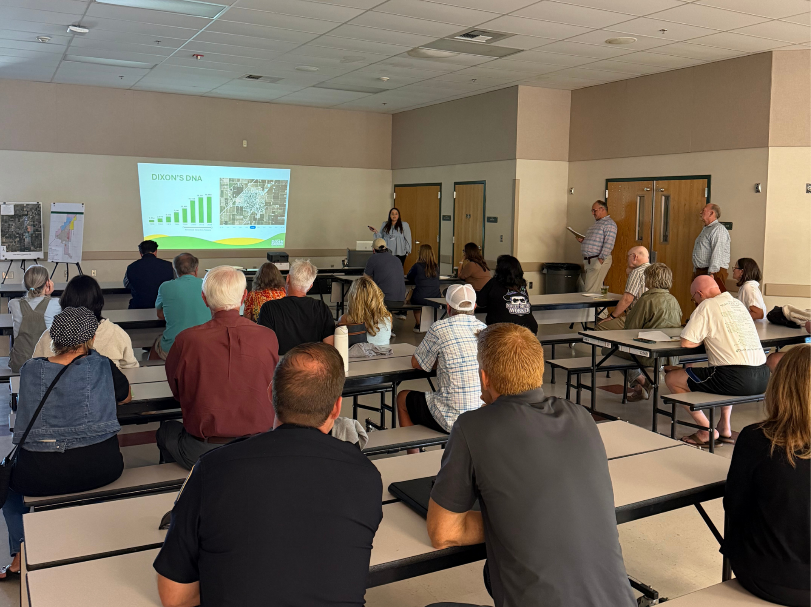
Workshop Highlights
The outreach campaign supported a series of 6 total community workshops conducted between March and April 2026, engaging more than 186 participants through virtual, district-based and citywide sessions.
Five in-person workshops were hosted in core community areas, including:
  Dixon Fire Department
  Senior Center
  Local schools
A representative from City Council actively participated in each session
Interactive format combined:
  Informational presentations
  Roundtable discussions
  Community sharing and feedback

Slide 10
Key Workshop Feedback
Protect Dixon’s Identity
  Desire to maintain friendly neighborhoods, historic downtown, agriculture and walkability that give Dixon its small-town character.
Focus on Infill
  Prioritize vacant lots and redevelopment to the extent possible by policy and economic considerations.
Growth Must Match Infrastructure
  Traffic, schools, utilities, transit, parking, public safety and maintenance must keep pace with development.
Strengthen Downtown and Local Economy
  Support local businesses, retail, arts/culture and housing affordability to keep jobs and spending local.
Invest in Community Amenities
  Strong interest in schools, parks, community centers, sports/recreation, cultural venues and safer bike/pedestrian access.
Continue Transparency and Input Opportunities
  Participants appreciate clearer planning, stronger developer accountability and more direct involvement in City decisions.
Protect Local Control
  Participants were interested in expanding the City’s influence over local development decisions, rather than leaving them to the county or neighboring jurisdictions.
Desire for Local Jobs and Union Contracts
  Participants want development to create more local jobs, expand union labor opportunities and deliver lasting economic benefits for the community.
Interest in Planning Investment
  Some of the participants feel because current planning efforts are developer-funded, the City should expand planning work even further.

Slide 11
How Policymakers Can Use This Information to Guide Next Steps
Maintain an active presence in the community to build trust, gather feedback and ensure community voices remain a central part of the consideration process.
Facilitate public education and outreach so residents and stakeholders understand project goals, policy constraints, potential impacts and opportunities for input.
Identify and evaluate community concerns for projects and incorporate them into planning and decision-making for thoughtful growth.
Complete thorough environmental reviews to assess project impacts and support informed policy decisions.

Slide 12
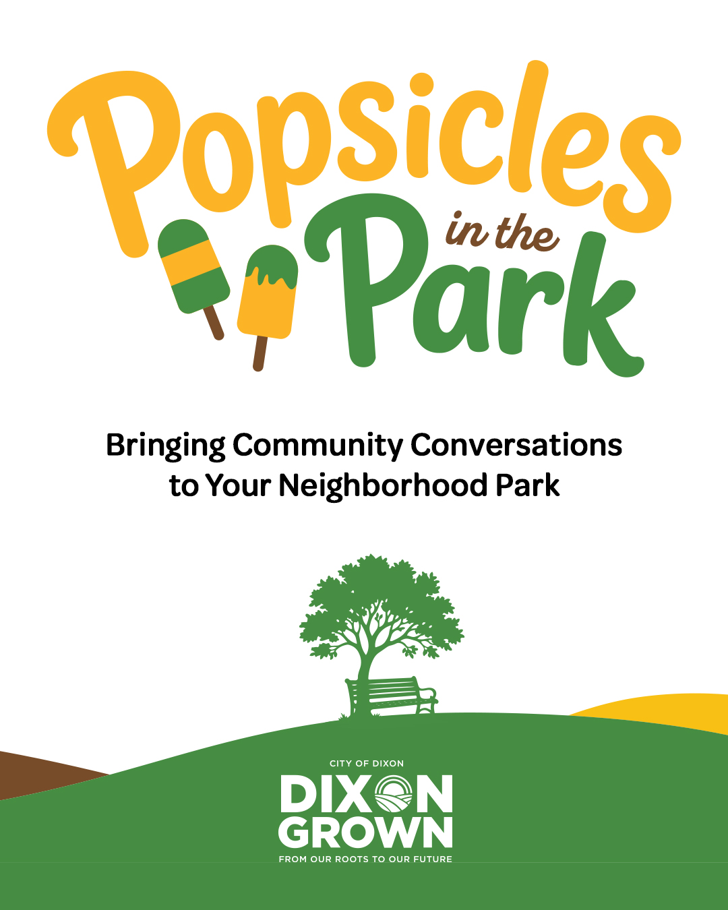
Future Efforts
Upcoming Summer Pop-Up Events + Promo
  Popsicles in the Park
  Coffee with a Councilmember
New Social Media Educational Efforts
  Content around FAQs, mythbusters, project progress and information regarding Dixon Grown and the development process.
Video Projects
  A short, documentary-style video introducing Dixon Grown.
  An animated video explaining the development process.

Slide 13
Revised CEQA Notice of Preparation (NOP)

Slide 14
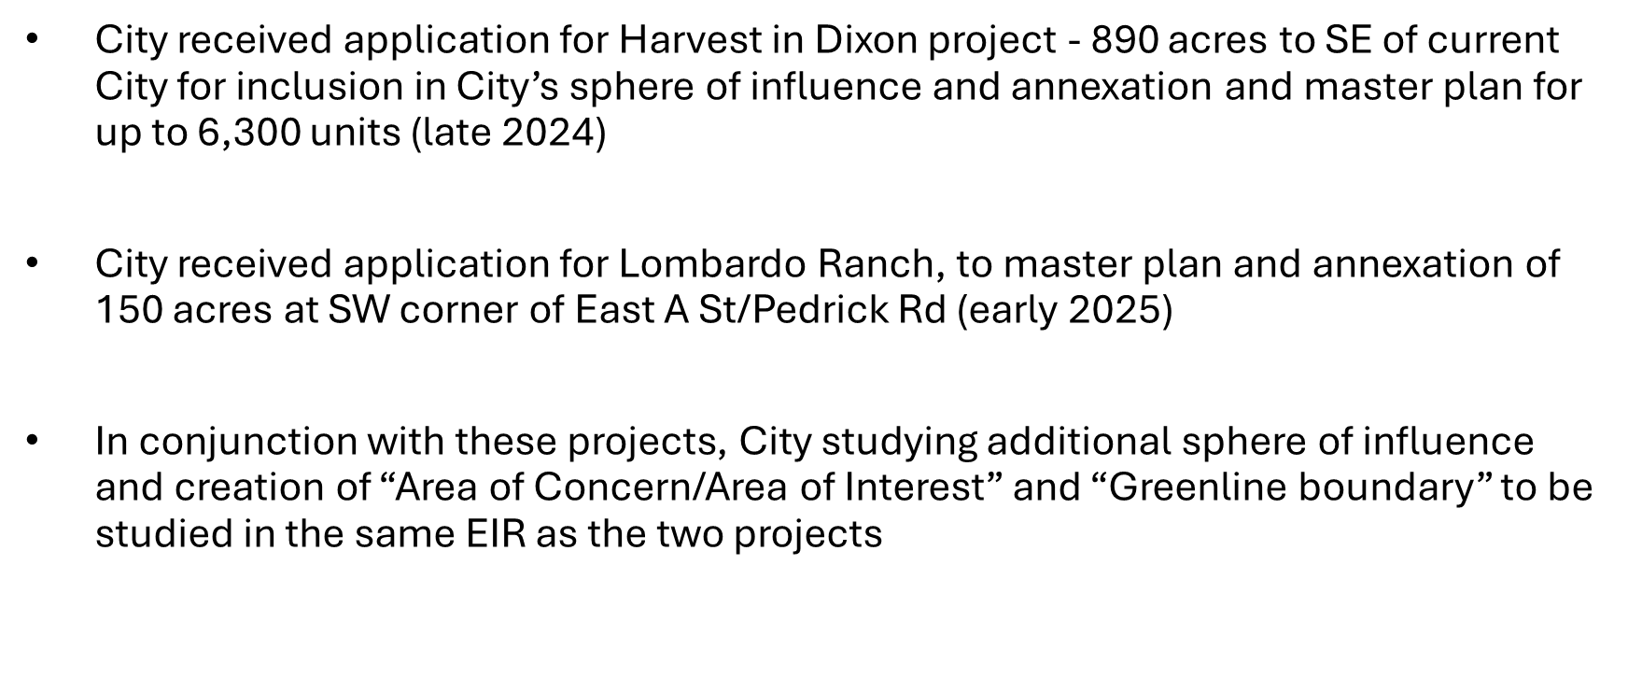
Harvest at Dixon/Lombardo Ranch Projects and City Growth of Sphere of Influence

Slide 15
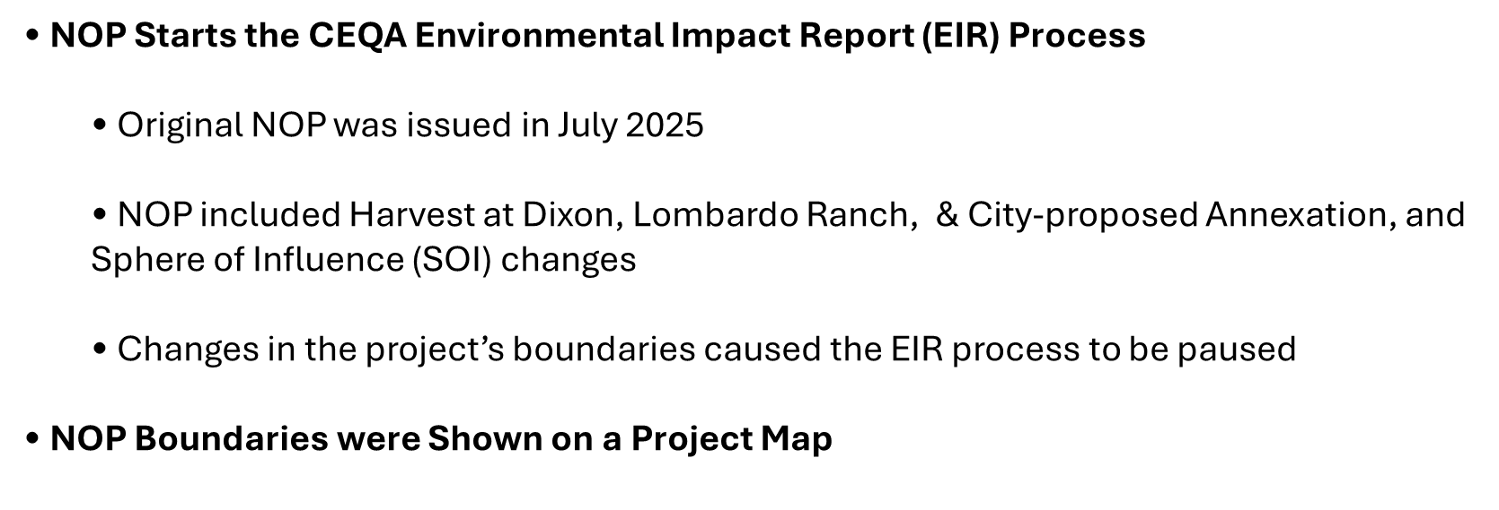
2025 Notice of Preparation (NOP)

Slide 16
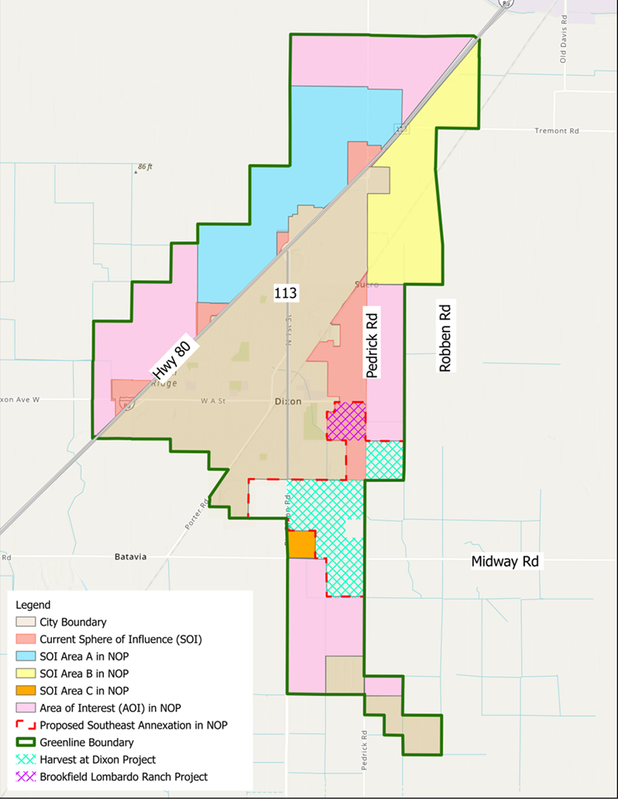
Original NOP Map (July 2025)
Concerns after publication of 2025 NOP map
  Proposed Spheres of Influence is Too Large
  The Ultimate Boundary Envisions Dixon as a Large City
  The SOI boundaries would likely be Contested by Other Agencies
  Additional infrastructure is needed to serve the SOI Areas

Slide 17
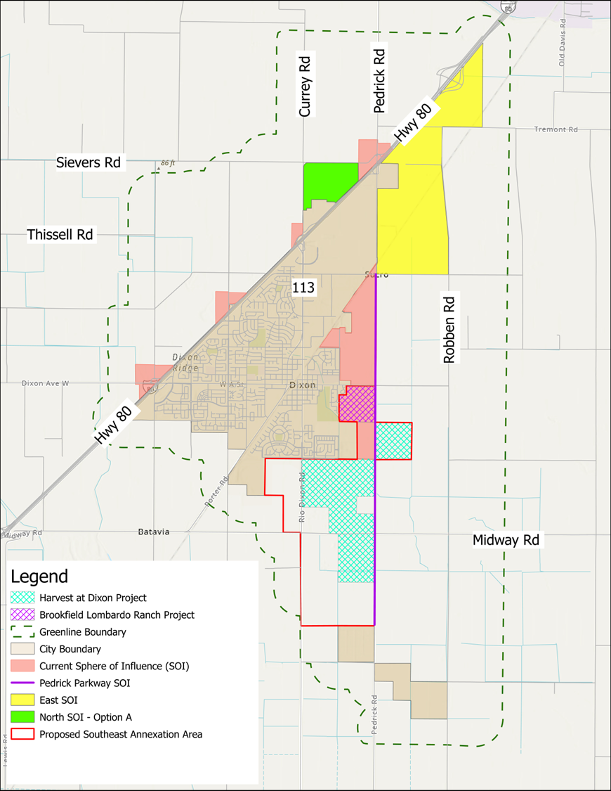
Revised 2026 NOP Map
Following comments on original map and further community outreach, revised map has been prepared revised NOP Map
  Reduced SOI North of Interstate 80
  New Pedrick Parkway SOI
  Proposed Annexation Area Expanded to Capture New Harvest Lands
  Proposed Annexation Area Would Also Connect the City to the City Wastewater Plant

Slide 18
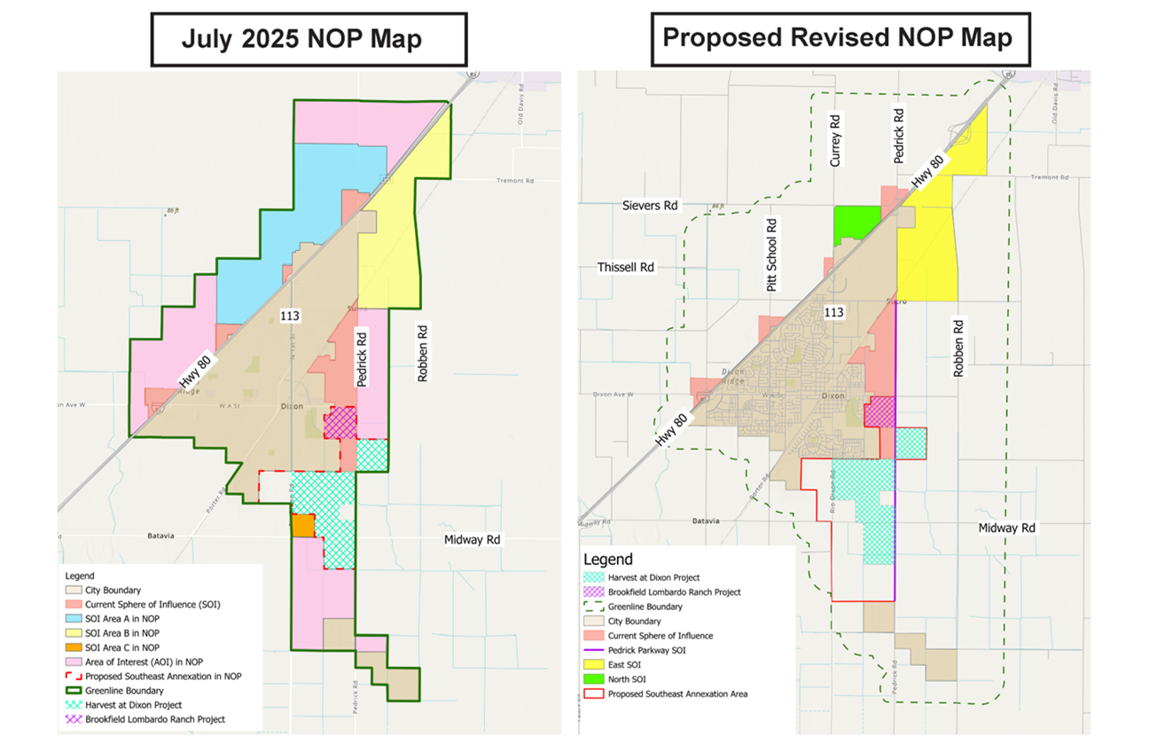
Comparison of Original vs Revised NOP Maps

Slide 19
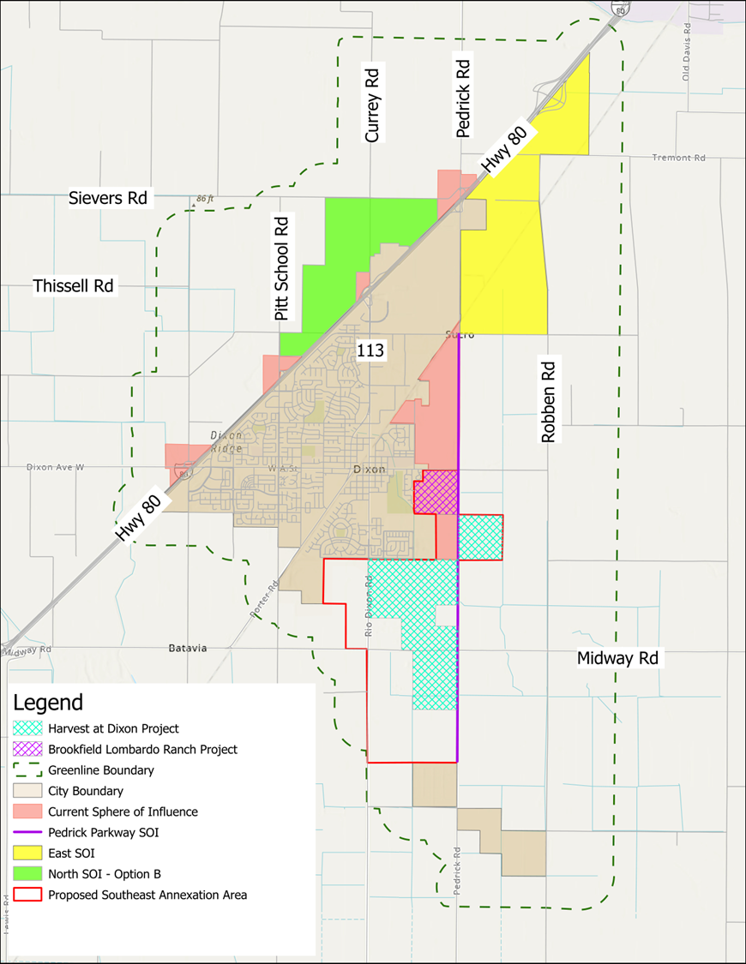
Alternative NOP Map with expanded North SOI
Includes approx. 550 acres of Gill Family properties added to North SOI, north of Interstate 80
Other than the North SOI, all other areas called out in the Revised 2026 NOP Map is identical to the Alternative Revised NOP map

Slide 20
Comparison of Revised and Alternative NOP Maps

Slide 21
Next Steps for Resubmittal of the NOP
Two maps presented to City Council
1. Revised 2026 NOP map; and
2. Alternative Revised NOP Map, with expanded North SOI
Other than the North SOI, all other areas called out in Revised 2026 NOP Map are identical,
except for expanded North SOI (Gill family holdings) north of I-80
Staff requests the Council review both maps presented and provide direction on which map
should be utilized for reissuance of the NOP
City will then issue and publish revised NOP Map for 30-day review/comment period

